Slide 1
Why is good grammar important?

Slide 3
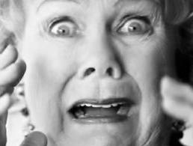
“Let’s eat Grandma!”
What??

Slide 5
Does proper spelling and word choice really matter?

Slide 6
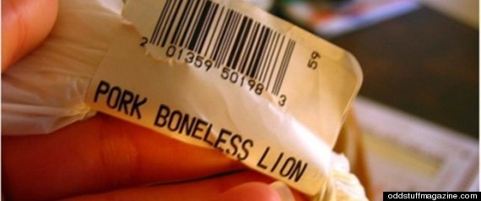
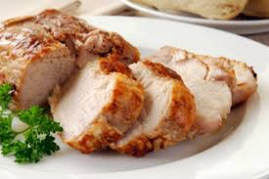
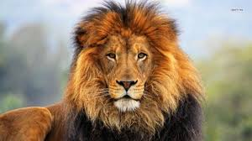
Pork Loin VS. Pork Lion

Slide 7
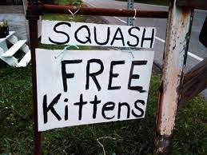

Slide 8
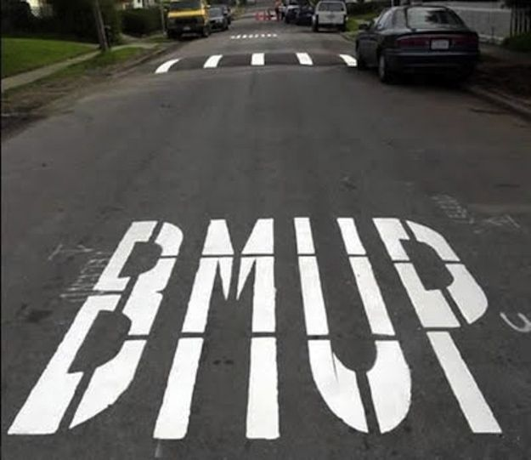

Slide 9
